Slide 1

AIRBNB HOTEL BOOKING ANALYSIS
PRIYARANJAN JANA
STU679b11869a7031738215814

Slide 2

PROBLEM STATEMENT
Airbnb is a popular platform where property owners rent out their homes or apartments for travellers. Unlike traditional hospitality providers, Airbnb operates on a commission-based model, facilitating transactions between hosts and guests without owning the properties listed on its platform.
One of the biggest challenges for hosts is determining the right price for their listings, as prices vary depending on several factors, including the number of bedrooms, bathrooms, cleanliness, accuracy of descriptions, and communication quality with guests.

Slide 3
Project Description
This project focuses on building a machine learning model to predict the price of Airbnb listings. Pricing an Airbnb property correctly is crucial for both hosts and travellers
This research analysis delves into the New York City Airbnb dataset to extract meaningful insights. Through rigorous data cleaning, exploratory analysis and visualisation techniques, the study aims to illuminate the dynamics of the city's lodging market. By discerning factors influencing listing availability. pricing strategies, and overall customer satisfaction. the research contributes to a deeper understanding of Airbnb's operations in one of the world's most dynamic urban environments. These insights hold significance for stakeholders and enthusiasts seeking to navigate the evolving landscape of short-term accommodation.

Slide 4

WHO ARE THE END USERS?
Airbnb Hosts
•To optimise pricing of their listings based on property features and guest reviews.
Travelers
•To evaluate whether a listing is overpriced or reasonably priced.
Airbnb Platform Analysts
•To improve automated pricing suggestions and increase platform trust.
Researchers/Students
•To study the impact of property features and reviews on rental pricing.

Slide 5

Technology Used
Python — Core programming language
Pandas & NumPy — Data cleaning and preprocessing
Scikit-learn — Machine learning (model training, regression, evaluation)
Matplotlib/Seaborn— Data visualisation and feature importance
Google Colab — Cloud-based environment for running the project
File handling libraries — openpyxl (for Excel) and built-in CSV handling

Slide 6
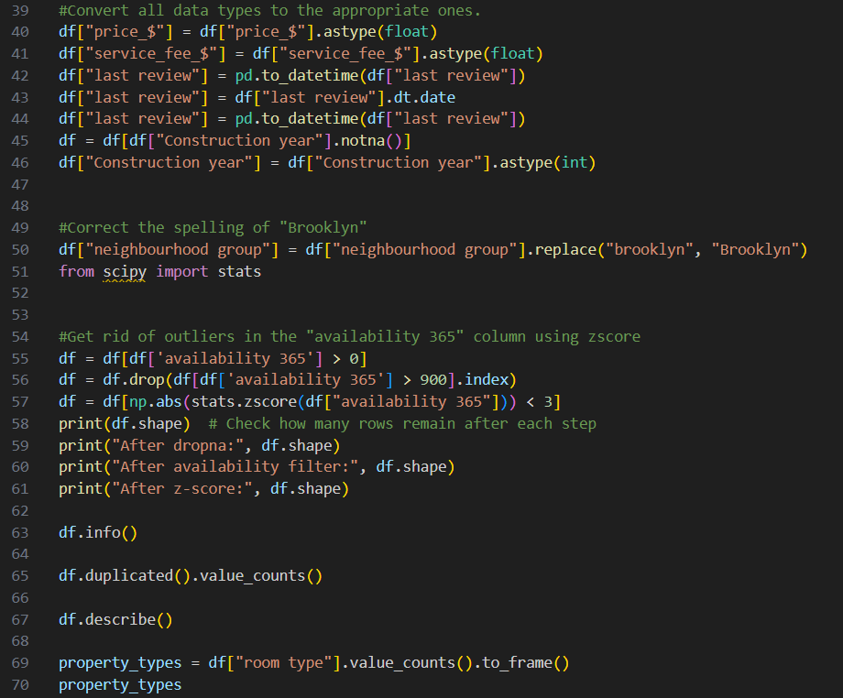
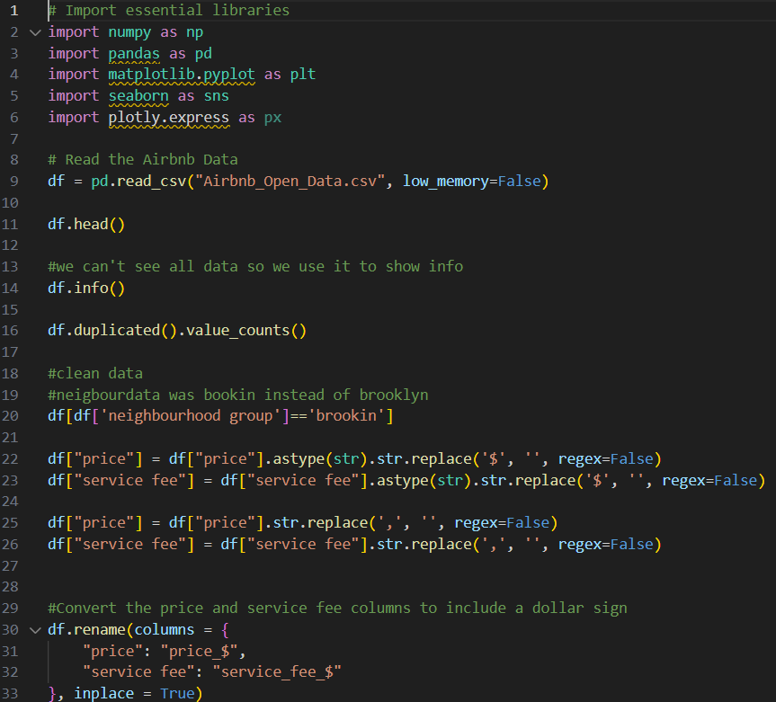
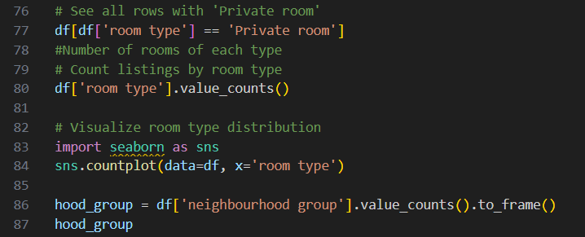
Python code
Demo Link

Slide 7
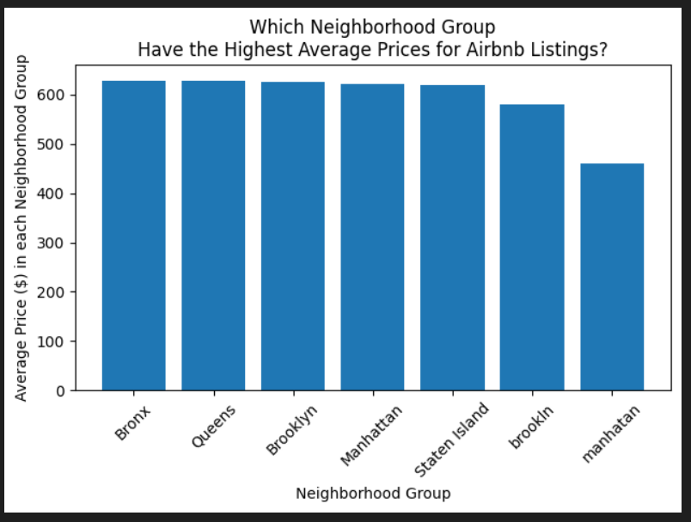
RESULTS1
Demo Link

Slide 8
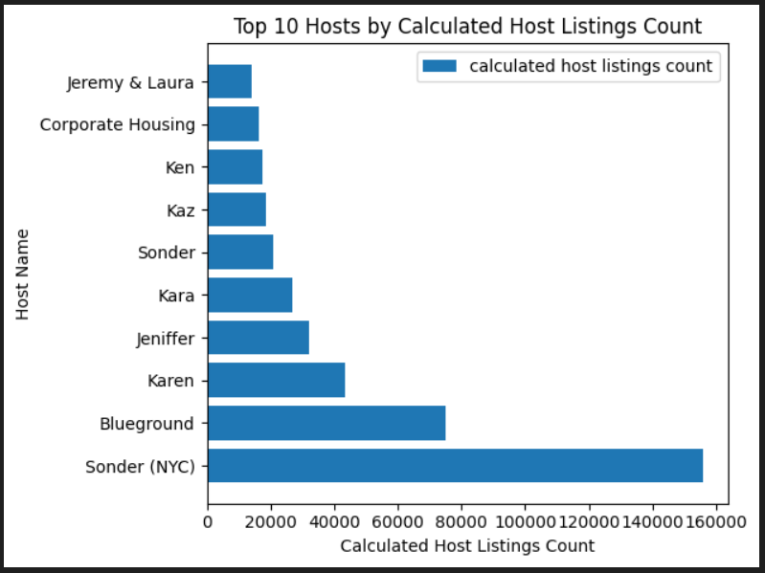
RESULTS2
Demo Link

Slide 9
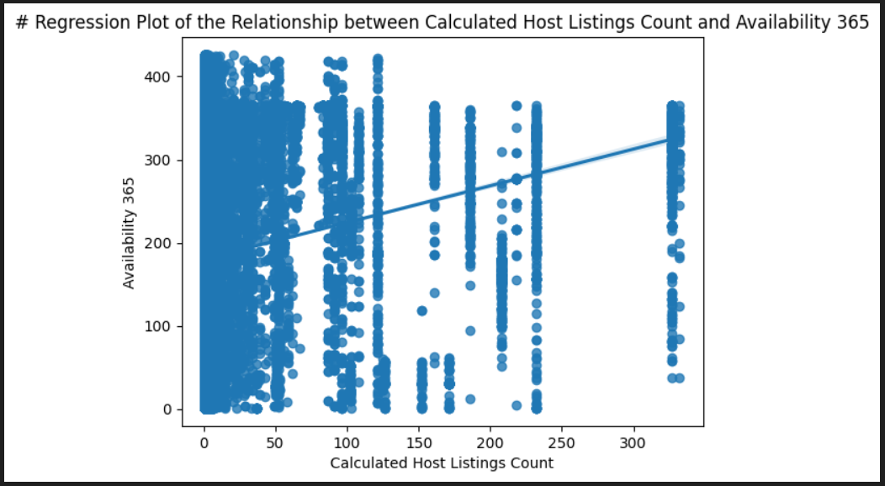
RESULTS3
Demo Link

Slide 10
GitHub repository
https://github.com/Priyaranjan25/VOIS_AICTE_Oct2025_PriyaranjanJana.git
Demo Link

Slide 11
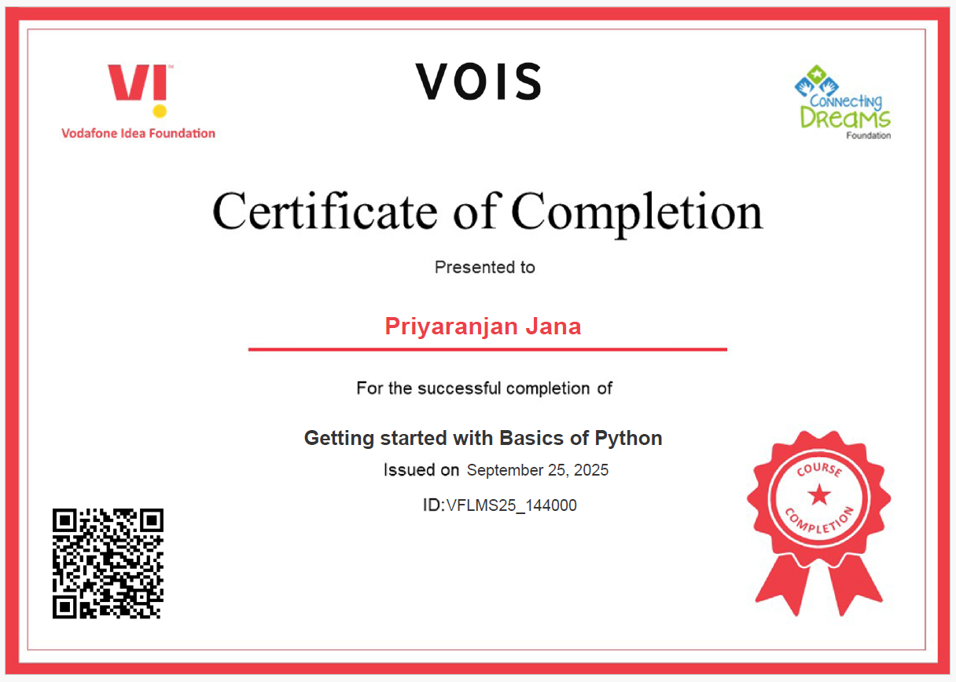
Getting started with Basics of Python Certificate

Slide 12

Data Visualization Certificate

Slide 13
Thank you
.
.

